Slide 1
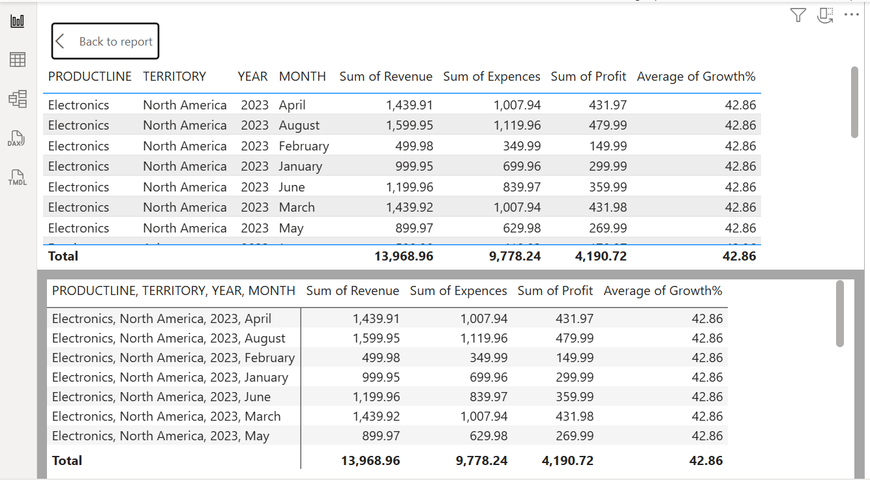
PPT summary of dashboards from Power BI
Export an Excel file into Power BI.
For Table: In visualization, select the Table option. Add columns to the Column section to represent your table.

Slide 2
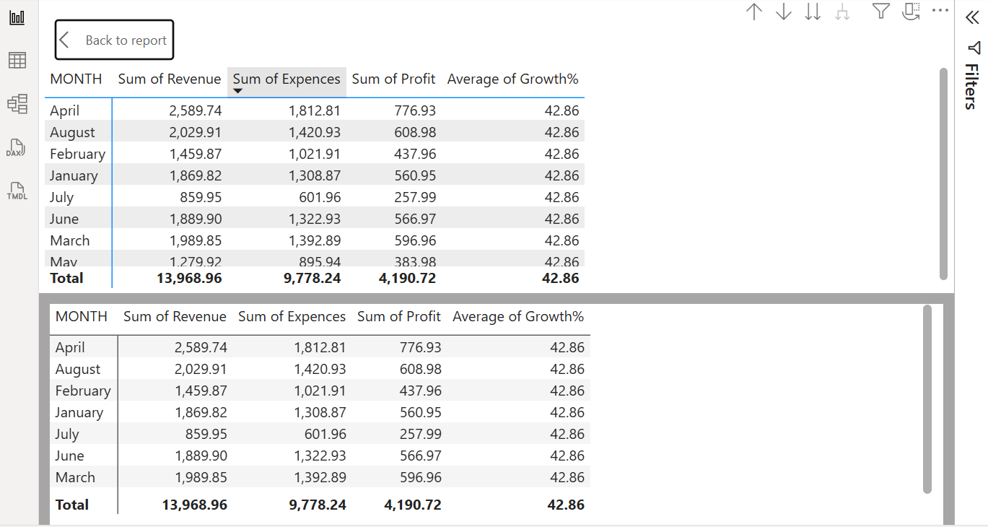
For Matrix: In visualization, select the Matrix option. Add columns like territory, year, month, and productline in the Rows section. Similarly, add the values contained columns in the Column section. Here in the matrix, there is a plus symbol, which shows the subdivision of columns of the table; it won’t take much extraspace, and also to make an easier to go through the data.

Slide 3
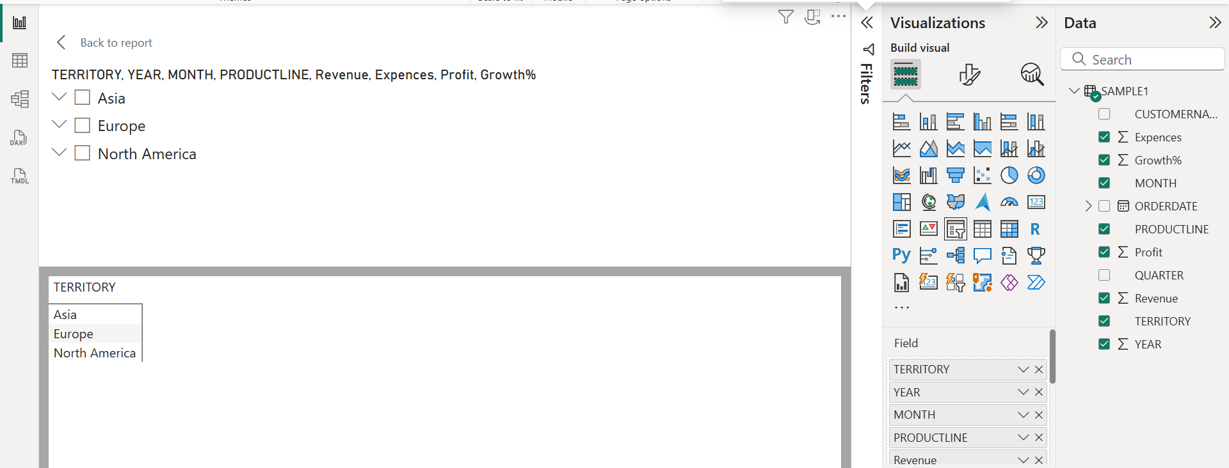
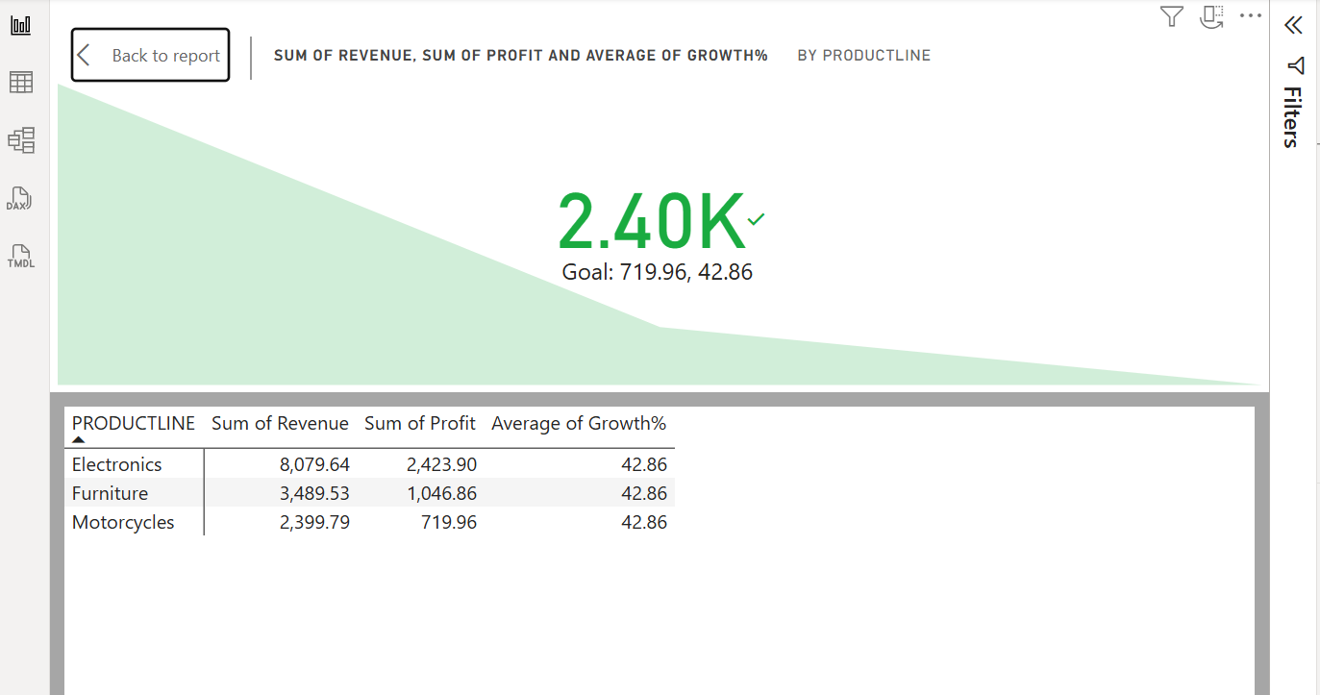
For Slicer: In visualization, select the Slicer option. Add columns like territory, year, month, productline, revenue, expenses, profit, and growthrate in the Rows section. It is the advanced representation of data compared to a matrix.
For KPI: In visualization, select the KPI option. Add columns like productline in the Trend axis section. Add columns like revenue in the Value section. Add columns like profit and growthrate in the Target section.

Slide 4
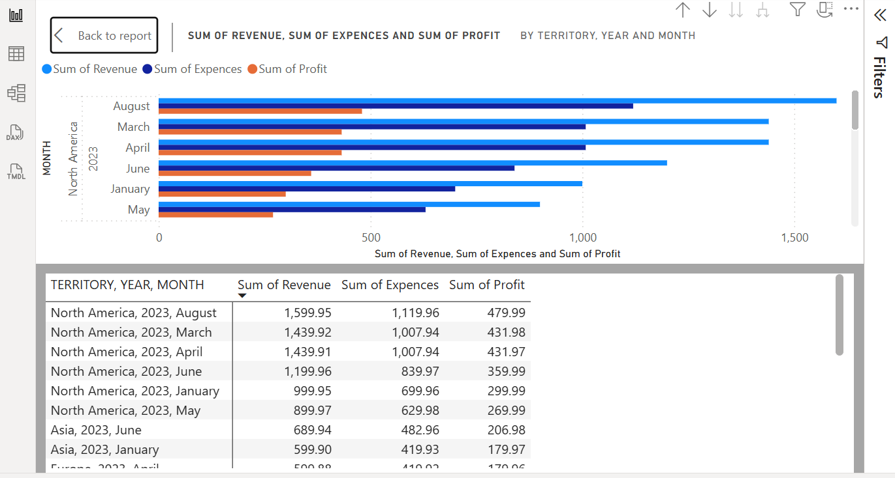
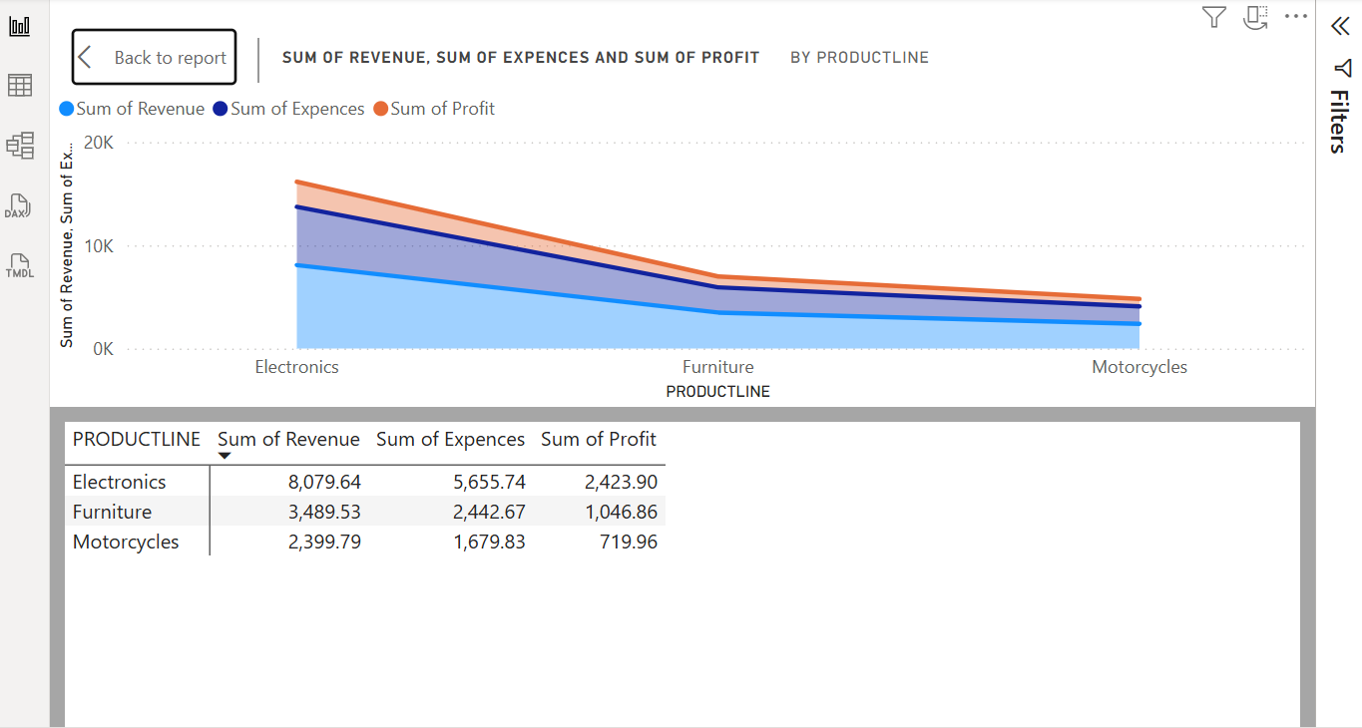
For Cluster Bar Chart: In visualization, select the Cluster Bar Chart option. Add columns like territory, year, and month in the Y-axis section. Add columns like revenue, expenses, and profit in the X-axis section.
For Stacked Area Chart: In visualization, select the Stacked Area Chart option. Add columns like revenue, expenses, and profit Y-axis section. Add columns like productline in the X-axis section.

